Slide 1
Project Quality Assurance System(PQAS)
“Quality is more important than quantity. One home run is better than two doubles." – Steve Jobs

Slide 2
OFS Brand
We build software and trust.
Deliver project/software on time.
Highly skilled resource.
“OFS” has good complete package for software development, but we frontians missing something and I feel it is “Quality” - Design ,Code and Testing.
Due to On-Time delivery, we are compromising with the quality.
On-Time delivery is primary, but QUALITY is more valuable.
Notes:
To change the quality of your software, you need to change the process used to create it”

Slide 3
Existing monitoring system
OFS follow good practices/model to develop the quality product, but I like to add one more layer on top our existing system.
PQAS is a top layer of our existing system. This system will ensure quality of the our project/software.
PQAS
iNia

Slide 4
Project Quality Assurance System
IEEE/ISO 9000 Definition of SQA : Software Quality Assurance is: a systematic, planned set of actions necessary to provide adequate confidence that the software development process or the maintenance process of a software system product conforms to established functional technical requirements as well as with the managerial requirements of keeping the schedule and operation within the budget are confines.
This new system will assure our quality at 3 levels:
Design
Code
Testing
Eligible resource (based on eligibility test) will be review quality at three levels.

Slide 5
PQAS - Work Flow
Reviewer group is build for design, code and testing based on eligibility test.
These 3 group need to prepare set up rules for review.
Developer need to raise ticket iNia for review. Code review ticket will send notification to the PQAS system then available reviewer can pick a task.
Reviewer review code and post review comment on the same ticket.
Developer should fix the review comments posted by the reviewer.

Slide 6
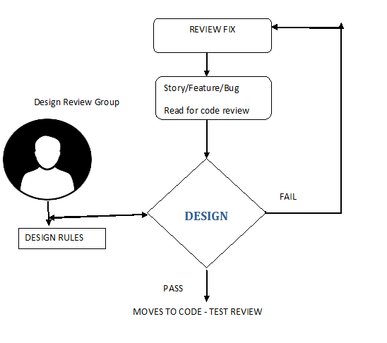
Design (Code) Review Flow

Slide 7
Design Review –Phase 1
Design reviewer can pick review task from the queue.
Developer need to fix the review comment, if review comment posted and re- assign to the same reviewer.
Same reviewer (based on the test) can able to review both design and code to consume less time for review.

Slide 8
TIEO Rule
TIEO team will manage and execute this NEW system.
TIEO resource must be part of review team.
TIEO members also can review, they also need to pass eligible test.

Slide 9
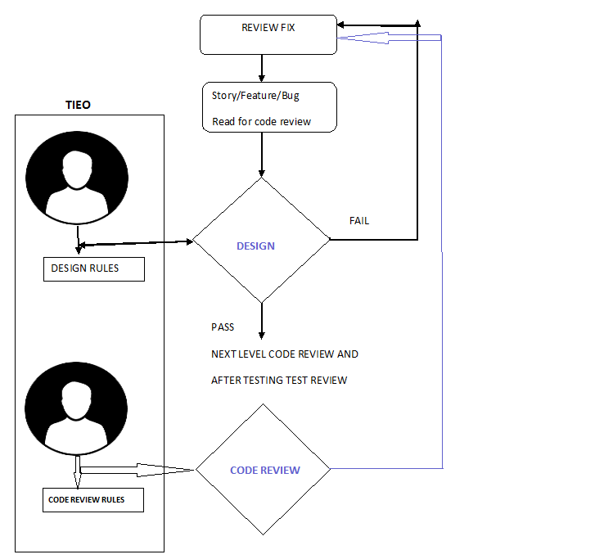
Code Review after design

Slide 10
Code and Testing review
Code review will start, after design review.
Test review will happen, after testing.
Need to have SLA at all the 3 review levels.
Only after 3 reviews, developer can move code into next level.
Developer can do check-in , if there is no review comment.
Task/feature will move to testing team for testing.
After testing only, it (story) moves to test review.

Slide 11
Reviewer up to date
Reviewer group need to have session periodically.
Reviewer need updated the current industrial standards and latest technologies updates.

Slide 12
Pros and cons
Pros
Quality assured delivery.
Client happy with delivery quality
Cons
More development time.
Delay delivery time.

Slide 13
Thanks
Some point may not be clear, My sincere apologies for that, since I have prepared this doc in a short time.
Kindly let me know, if you have any concern.
I hope this new system will help us to improve our product/software quality.
Thanks for this given opportunity.
……LETS ROCK AS FRONTIANS………

